Slide 1


STUDENT DATABASE MANAGEMENT SYSTEM

Slide 2




PACKAGES USED IN SDBMS
mysql.connector, pandas, texttable, prettytable, pymysql, xlwtpandas.io.sql
FUNCTIONS IN SDBMS
input_detail(self)
displayAllStudents(self)
displaystudent(self,query,namei)
displayStudentsByConstraints(self,query,nam)
displayStundetbyName(self)
displayStudentbyRoll(self)
displayStudentbyID(self)
deleted_A_student(self)
displayStudents_who_Intrested_in(self)
deleteAllStudent(self)
displayStudent_exam_marks_with_limit(self)
exportDatatoXls(self)
displayStudent_exam_marks_failed(self)

Slide 3


By using import mysql.connector module we connected SQL database to SDBMS project
With the help of from pymysql import * module implemented export file function
DETAILS REGARDING DATABASE
DATABASE NAME: studentdb
DATABASE TYPE: MYSQL
TABLES USED: studentdetail
RECORDS INSERTED : 45
TABLE_COLUMNS :aur, studentname, roll, email, codechef, marks, state, interest, id
Operations used are insert, show, where, create, is etc..

Slide 4
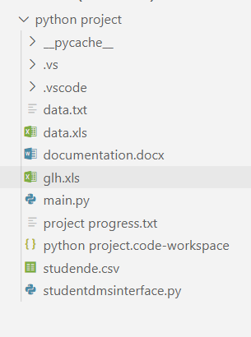

Student DataBase Management System Project Folder Detailization
Data exported from the program
Documentation of project
Main Project runner file
Project work time line and status manager
Excel file import file to the data base or raw data
Utility function python file all functions and operations
Project googledirve link: click me!
Project GitHub Link: visit saiguptha2003GitHub Repository

Slide 5
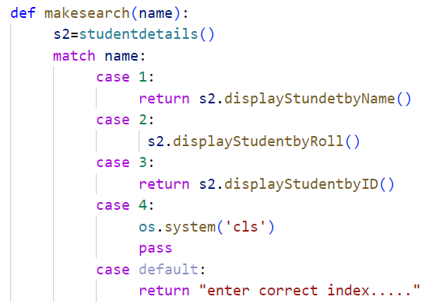
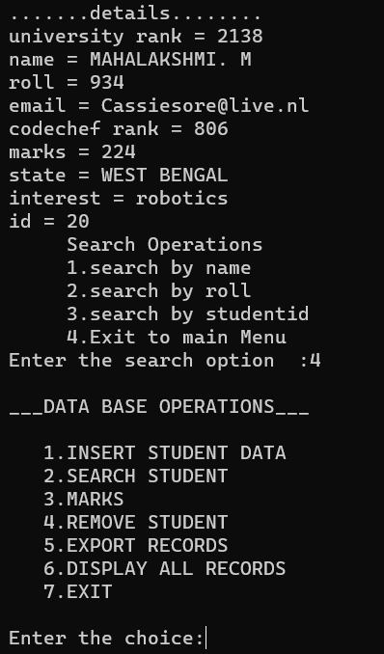
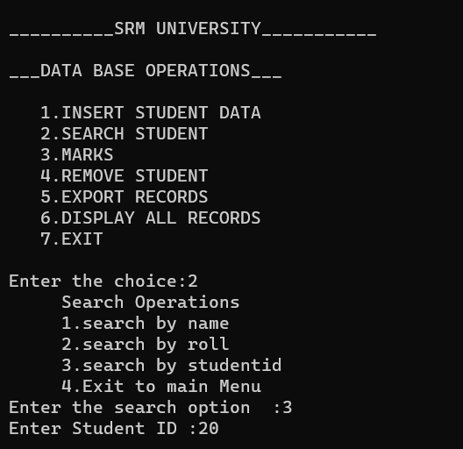

Match keyword plays a important roll in decision making

Slide 6
THANK YOU

